Slide 1

OLUS

Slide 2
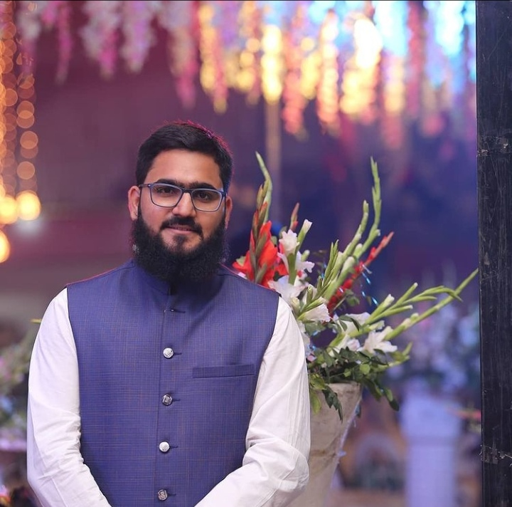
Personal Profile
BBA (IOBM)
MAJORS IN MANAGEMENT
PCB CIRCUIT DESIGNER
&
BUSINESS DEVELOPMENT MANAGER
Muhammad Hassan
Yousfani

Slide 3
Personal Profile
Hey, I’m Muhammad Hassan studying BBA with majors in management from IOBM. I belong from small city located in Sindh, Pakistan. I’m very confident and potential individual who has done intermediate from The Educators Tando Allahyar back in 2018. as far as experience is concern, I’m having experience of almost four years in assembling mobile related products and one year in PCB Designing and soldering components.
I’ve started my entrepreneurial journey on 5th November 2021. The idea was to use the skills, knowledge and experience to produce something very much affordable and better product rather than so called already existing products.

Slide 4
OUR COMPANY
OLUS is an online startup. It is an manufacturing and production of mobile related products including; traveling chargers, adaptors, data cables, charging cables, earphones, headphones. A primary concern was to produce sober and stylish in design and affordable for everyone. deliver high class and topnotch products with reasonable prices. and we don't comprise on quality. Since, our products are customer oriented.

Slide 5
OUR VISION
Our vision is to deliver high class and topnotch products with reasonable prices and we don't comprise on quality. Since, our products are customer oriented.

Slide 6
OUR MISSION
Our mission is to win the hearts and souls of our every customers by producing and delivering better products at very much reasonable and affordable prices.

Slide 7
OUR CORE VALUES
CUSTOMER SERVICE
AFFORDIBILITY
CUSTOMER SATISFACTION
QUALITY

Slide 8
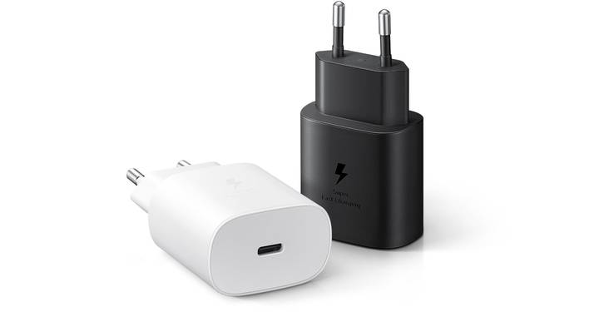
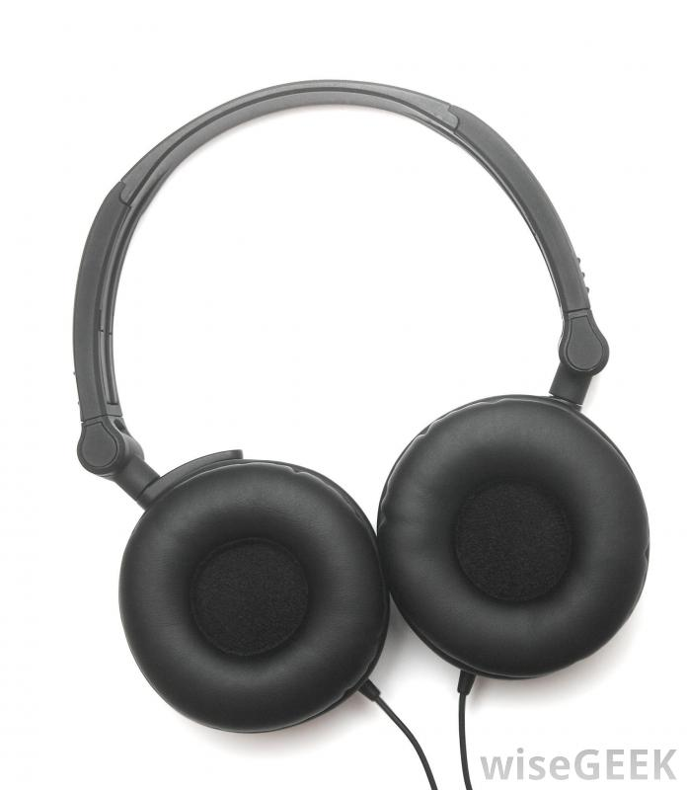
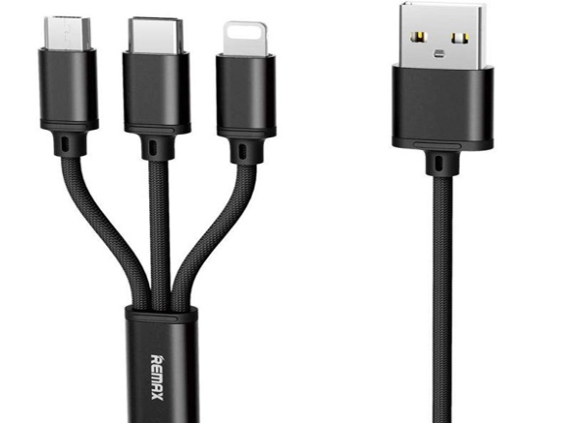
OUR PRODUCTS
AVAILABLE PRODUCTS:
PRODUCT SPECIFICATIONS:
MODEL # OP-04
DC5V-2.0 AMP
SHOCK RESISTOR
TRAVEL ADAOTOR
FUTURE PRODUCTS:
EXPECTED BY APRIL 2022
CABLES
EARPHONES

Slide 9
OUR CORPORATE SOCIAL RESPONSIBILITY (CSR)
We are aiming at economic development through our business. We appreciate and say warm welcome to those who really wants to learn and start his/her venture. We wouldn’t only share our expertise with our employee but also with the one who really is passionate about the work and want to contribute for the betterment of Pakistan.

Slide 10



OUR AVAILIBITY
https://www.facebook.com/OLUSPAKISTAN/
https://www.instagram.com/ourlifeup_state/
+923353645968
+923078220185

Slide 11
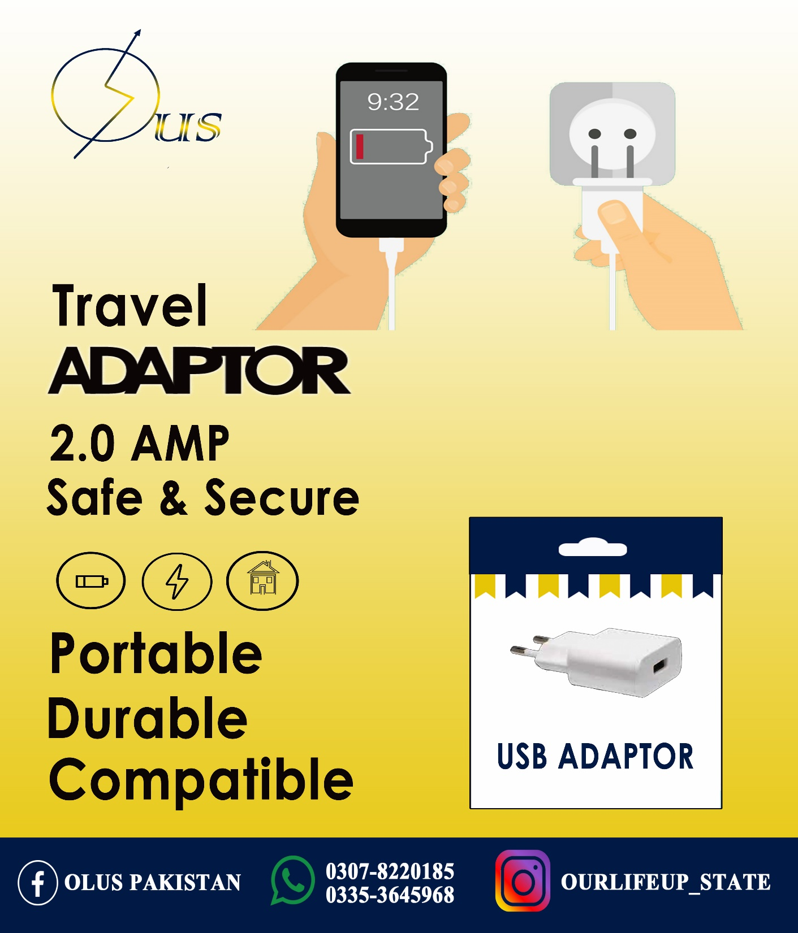
OUR POSTER

Slide 12


OUR BUSINESS CARD

